Slide 1


Introduction to .NET MAUI
James Montemagno
Principal Lead PM – Developer Community, Microsoft
@JamesMontemagno
/JamesMontemagno

Slide 2
Agenda
Introduction to .NET MAUI
Building our First App
MVVM & Data Binding
Navigation
Accessing Platform Functionality
Displaying Data
App Themes

Slide 3
Machine Setup

Slide 4
Code & Walkthrough aka.ms/maui-workshop

Slide 5








.NET – A unified development platform
ECOSYSTEM
TOOLS
NuGet
Visual Studio
CLOUD
WEB
DESKTOP
MOBILE
GAMING
IoT
AI
.NET 6
GitHub
Visual Studio for Mac
COMMON BASE LIBARIES/APIs
Components, tools, library vendors
Visual Studio Code
INFRASTRUCTURE
RUNTIME COMPONENTS
COMPILERS
LANGUAGES
CLI

Slide 6










Slide 7








Swift
Swift
JS
JS
iOS
iOS
JS
Swift
JS
JS
Swift
JS
JS
Java
.NET
JS
Java
C++
Java
C++
JS
Obj-C
Kotlin
Obj-C
Java
Obj-C
macOS
Kotlin
Kotlin
Obj-C
Kotlin

Slide 8




iOS
iOS
macOS
.NET
.NET
.NET
.NET
.NET
.NET
.NET
.NET
.NET
.NET
.NET
.NET
.NET
.NET
.NET
.NET
.NET
.NET
.NET
.NET
.NET
.NET
.NET
.NET
.NET
.NET
.NET
.NET
.NET
.NET
.NET
.NET
.NET
.NET
.NET
.NET
.NET
.NET
.NET
.NET
.NET
.NET
.NET
.NET
.NET

Slide 9


Slide 10
An open-source app platform
from Microsoft for building
modern, performant, & multi-platform
iOS, Android, macOS, & Windows apps
with C# and .NET from a
single shared codebase.

Slide 11

.NET MAUI App Architecture
C#
C#
C#
C#
Shared Code
UI, Resources, Platform Features, & Business Logic

Slide 12




Productive environment
Maximize code reuse
Native performance & integrations
Expansive ecosystem

Slide 13

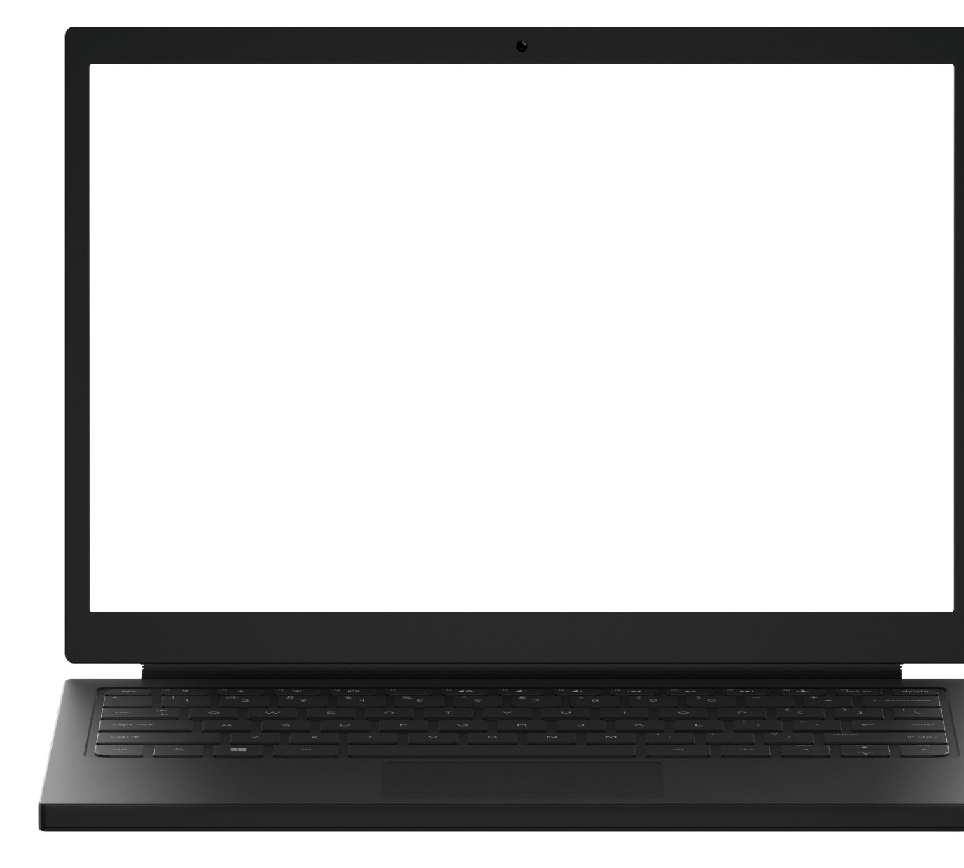
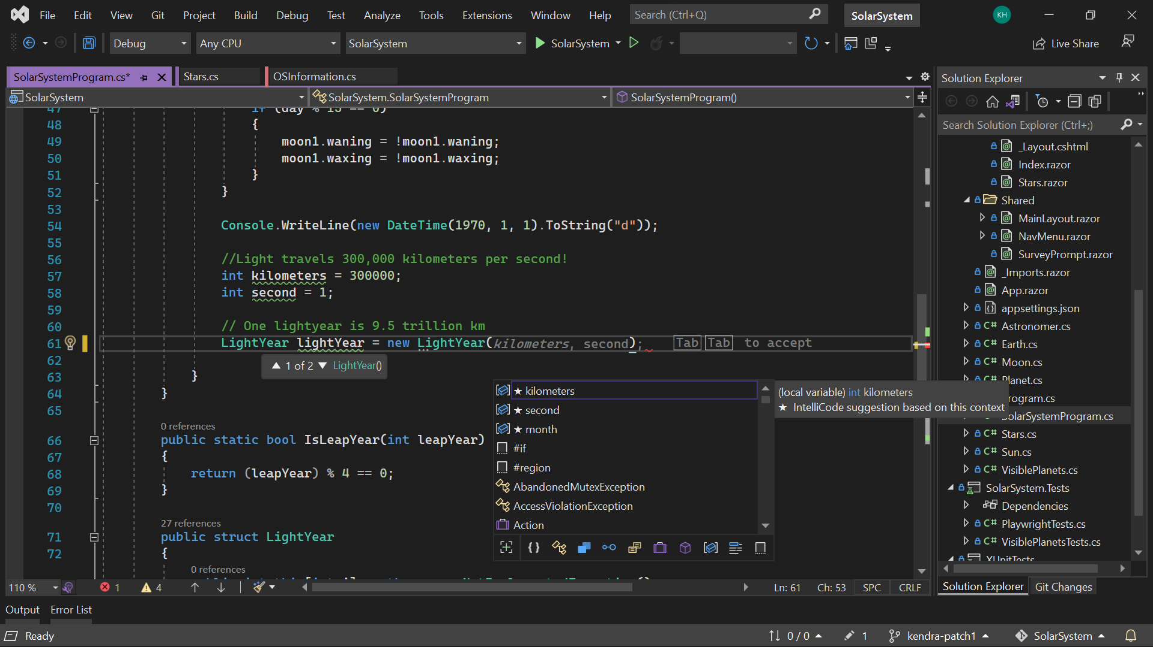
Visual Studio 2022
Modern development
Build innovative, modern apps using .NET 6, GitHub and Azure with integrated tooling
Personal and team productivity
Live Share, Hot reload everywhere, Web live preview, IntelliCode, enhanced debugging and testing tools
Scale to projects of any size
An optimized, modern UI built on 64-bit architecture to support the largest, most complex codebases and workflows
VisualStudio.com/download

Slide 14

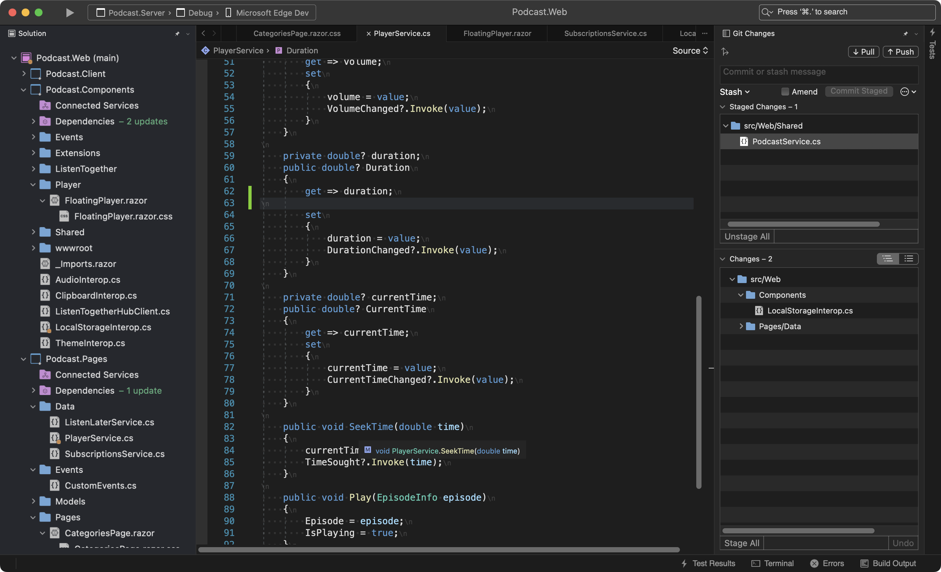
Visual Studio 2022 for Mac
Fast and Fluid
Focused on performance with over 100 user reported issues fixed; running on .NET 6 and with native support for Apple’s M1 processor
Modern macOS UI
A rewritten UI, using native macOS Cocoa APIs. With native theming, full screen support, and macOS accessibility tooling.
Support for .NET 6
Build for the web, cloud, and (soon) mobile, using .NET 6.
https://aka.ms/vsmac-preview

Slide 15
Cross-Platform UI

Slide 16




UIActivityIndicator
ProgressBar
UISlider
SeekBar
ActivityIndicator
Slider

Slide 17
Controls
CarouselView
CollectionView
ListView
Picker
TableView
IndicatorView
ProgressBar
ActivityIndicator
Editor
Entry
CheckBox
DatePicker
Slider
Stepper
Switch
TimePicker
Button
ImageButton
RadioButton
RefreshView
SearchBar
SwipeView
BlazorWebview
Border
BoxView
Frame
GraphicsView
Image
Label
ScrollView

Slide 18

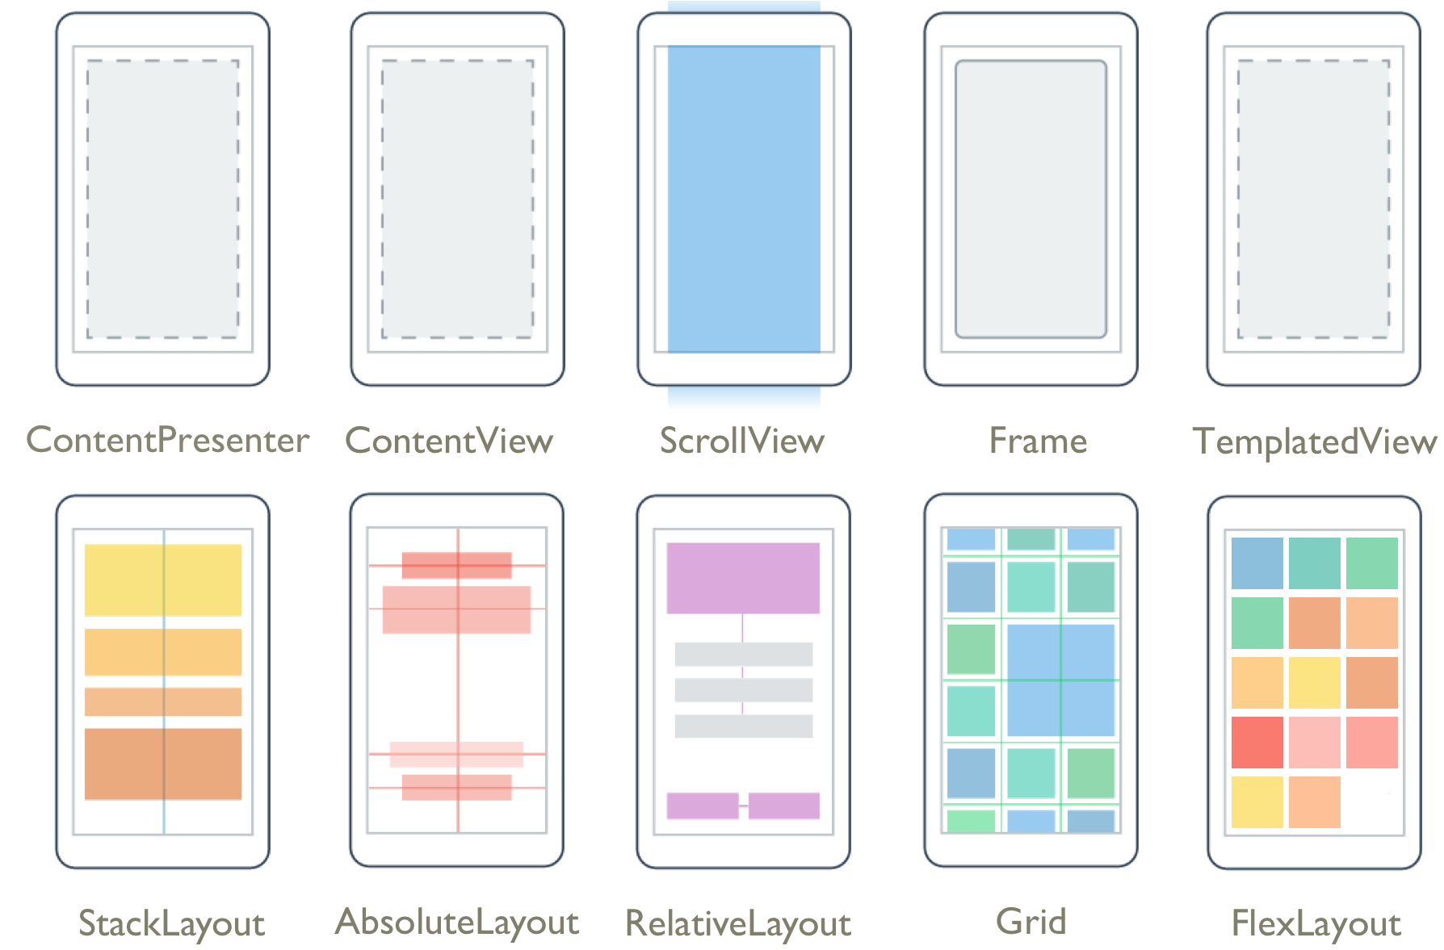
Layouts
Pages
Content
Flyout
Navigation
Tabbed

Slide 19
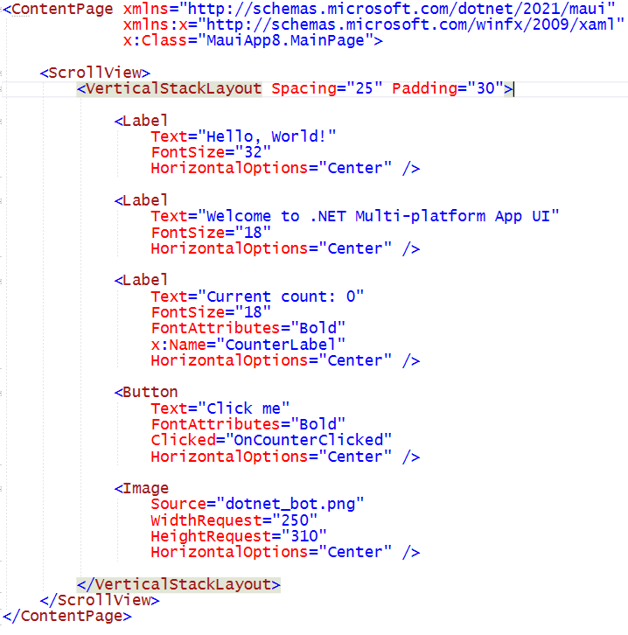
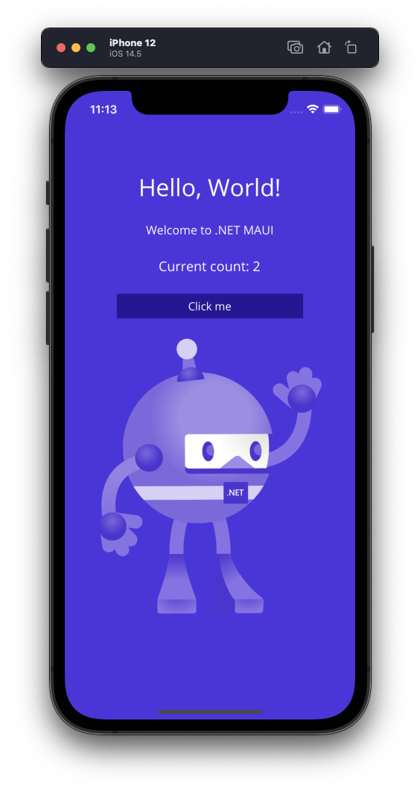
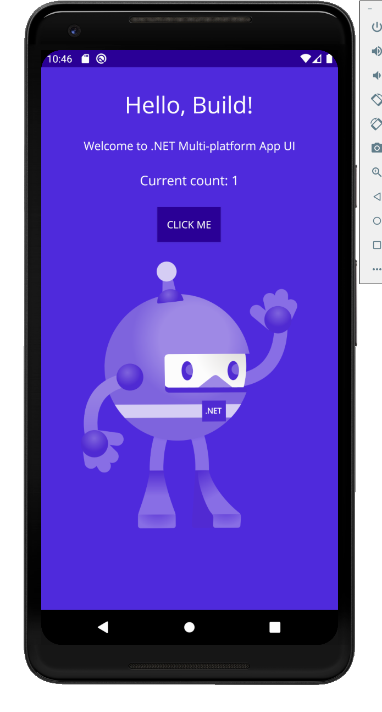
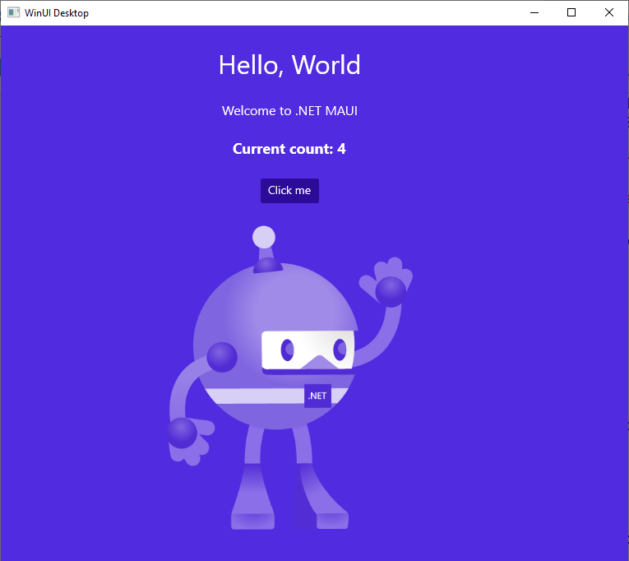
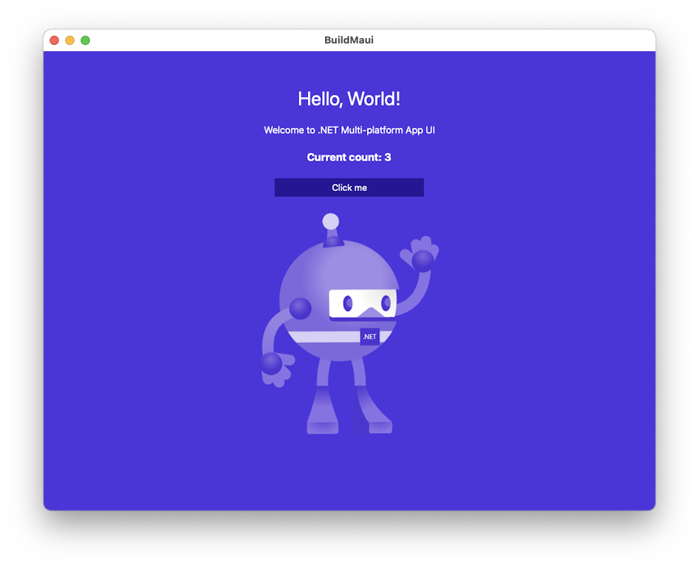

Slide 20
Platform API Access

Slide 21
iOS
MapKit
UIKit
SiriKit
ARKit
CoreML
System.Net
System
System.IO
System.Linq
System.Xml
System.Data
System.Windows
System.Numerics
System.Core
System.ServiceModel
C#

Slide 22
Android
Fingerprint
Bluetooth
Picture-in-Picture
Geolocation
NFC
System.Net
System
System.IO
System.Linq
System.Xml
System.Data
System.Windows
System.Numerics
System.Core
System.ServiceModel
C#

Slide 23

Cross-Platform APIs
Sms
Secure Settings
Preferences
Flashlight
Clipboard
Gyroscope
Magnetometer
Geolocation
Phone Dialer
Device Display Info
Email
Device Info
Battery
Compass
Accelerometer
Screen Lock
Data Transfer
Text to Speech
Geocoding
File System
Connectivity
Vibration

Slide 24
Geolocation Example
// Get cached location, else get real location.
var location = await Geolocation.GetLastKnownLocationAsync();
if (location == null)
{
location = await Geolocation.GetLocationAsync(new GeolocationRequest
{
DesiredAccuracy = GeolocationAccuracy.Medium,
Timeout = TimeSpan.FromSeconds(30)
});
}

Slide 25
Geolocation Example
// Register service
builder.Services.AddSingleton<IGeolocation>(Geolocation.Default);
// Inject service
IGeolocation geolocation;
public MyViewModel(IGeolocation geolocation)
{
this.geolocation = geolocation;
}

Slide 26
Performance

Slide 27
Built on trusted technology
ARM BINARY
IL + JIT
.NET
.NET
AOT
.APP
Compile and Link
.APK
C#
C#
Runs natively
Runs natively
Bindings
Bindings
.NET for iOS does full Ahead Of Time (AOT) compilation to produce an ARM binary for Apple’s App Store.
.NET for Android takes advantage of Just In Time (JIT) & Ahead of Time (AOT) compilation on the Android device.

Slide 28
Full App Platform
✓ 40+ Pages, layouts, and controls
(Build from C# or XAML)
✓ Two-way data binding
✓ Navigation
✓ Visual State Manager
✓ Animation API
✓ Dependency Service
✓ Messaging Center
✓ CI/CD Support
✓ Hybrid Development with Blazor
✓ Platform API Access
✓ Images, Icons, Fonts, Splash Screens
✓ Custom & Default Themes
C#
C#
C#
C#
Shared Code
UI, Resources, Platform Features, & Business Logic

Slide 29
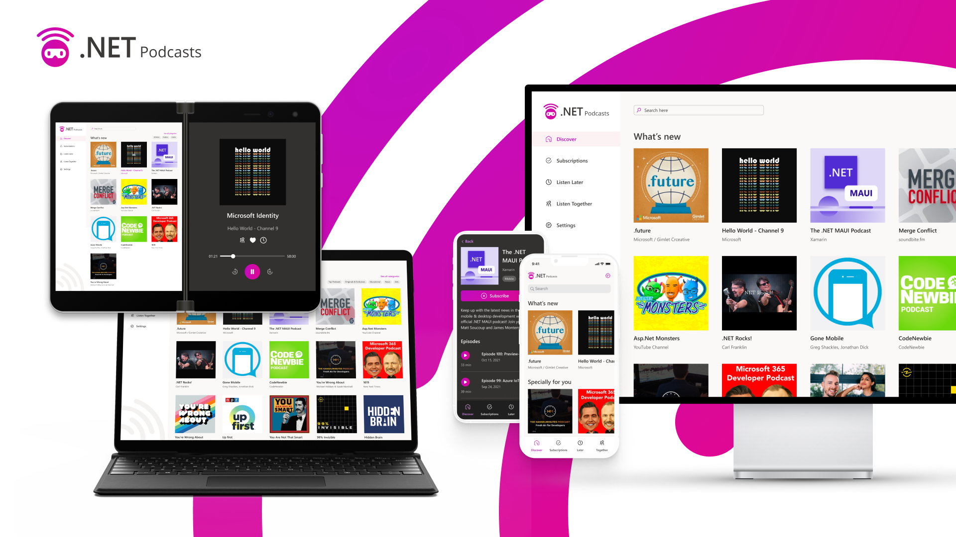

Slide 30
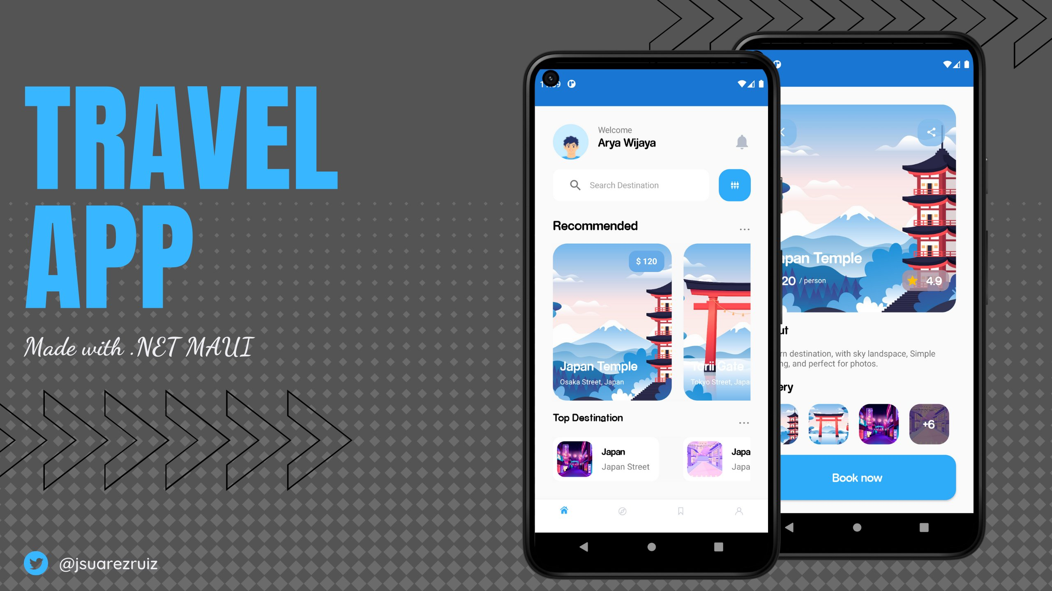

Slide 31
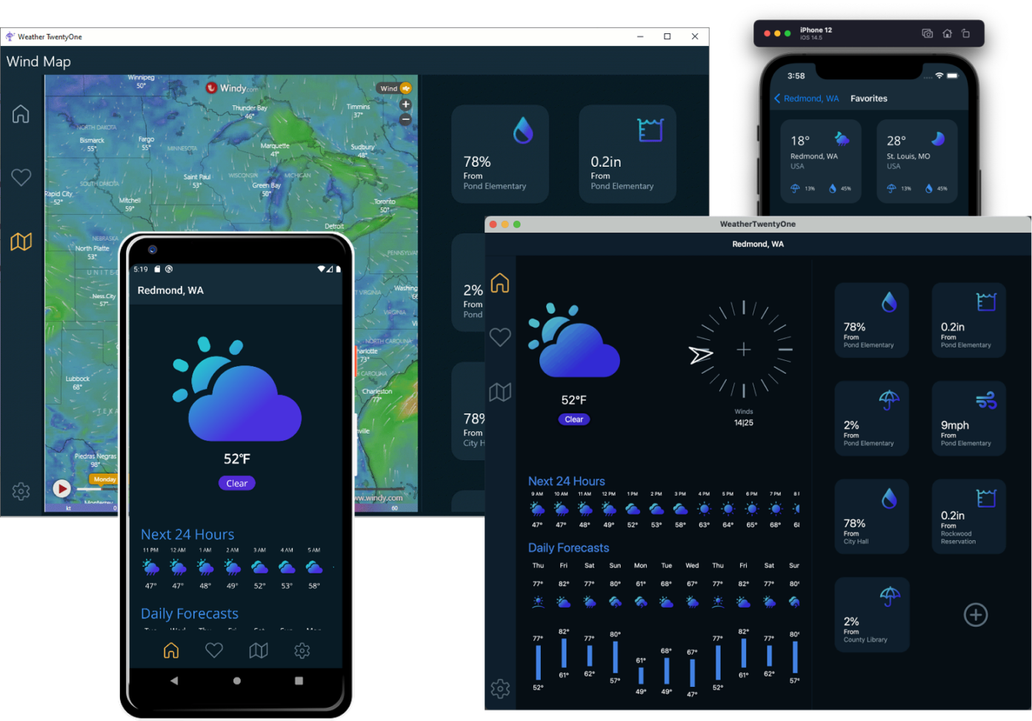

Slide 32


.NET MAUI Ecosystem

Slide 33
.NET MAUI
.NET 6
Cross-platform, native UI
Single project system, single codebase
Cross-platform, device API access
Native compilation, native performance
Deploy to multiple devices, mobile & desktop
.NET MAUI
WinUI
Mac Catalyst
iOS
Android
macOS
iOS
github.com/dotnet/maui

Slide 34
What about web developers?

Slide 35








Web development with .NET
ASP.NET Core
Blazor
JS

Slide 36



Blazor is flexible. You have choices.
Blazor Server
Blazor WebAssembly
Blazor
Blazor
DOM
SignalR
.NET
Razor Components
DOM
.NET
Razor Components
WebAssembly

Slide 37






Blazor

Slide 38




Blazor Hybrid:
+

Slide 39
Hybrid Architecture - .NET MAUI & Blazor
C#
C#
C#
C#
C#
Shared Blazor Components
Shared Business Logic

Slide 40
Hybrid app benefits
Reuse existing web development skills and code
Access to all the native platform capabilities of the device
Mix native & web UI
Reduce app development time
Ship seamlessly to app store or internal distribution

Slide 41
.NET brings rich choices for devs and dev teams
Blazor
Blazor Hybrid
(Blazor + .NET MAUI)
.NET MAUI
Reach
Power
Site
PWA
Native App
with WebView
Native App
Web
Hybrid
Native

Slide 43







Your platform for building anything
Desktop
Web
Cloud
Mobile
Gaming
IoT
AI
.NET

Slide 44

Q&A
Weekly development podcast
mergeconflict.fm
James
Montemagno
Principal Lead PM – Developer Community, Microsoft
motz@microsoft.com
montemagno.com
@JamesMontemagno
/JamesMontemagno

